Slide 1

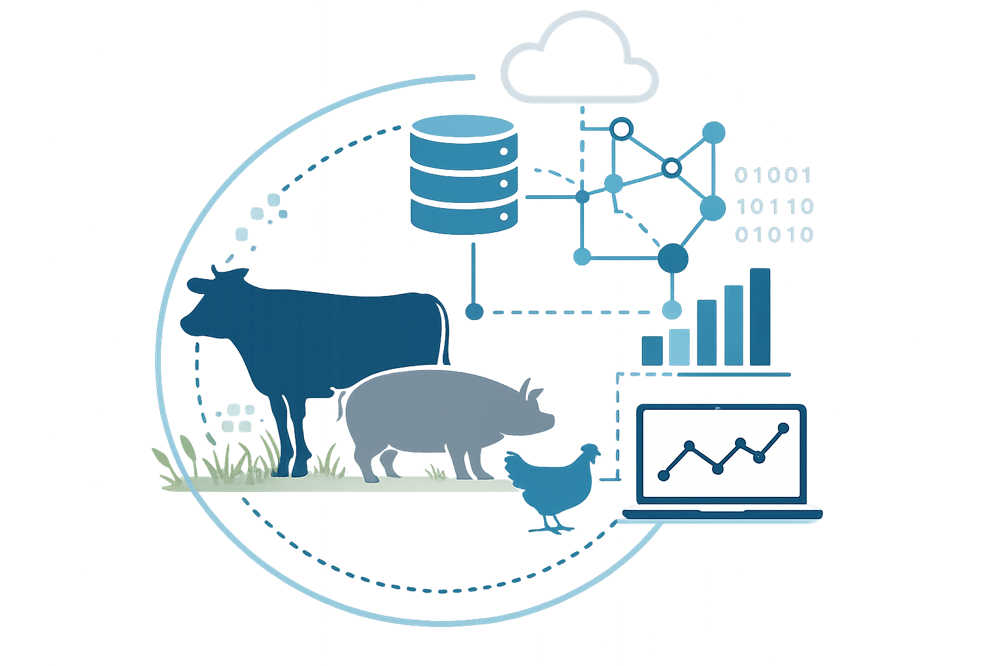



From Raw Files to Trusted Data Data Lineage and governance in practice
Puchun Niu, Enhong Liu, Hanlu Zhang, Ermias Kebreab, Jennifer Ellis, Mutian Niu, Stephanie Terry, Fran Cowley, Lyle Rode, Miel Hostens

Slide 2
FAIR Data Principles
How the GEMS pipeline makes movement data Findable, Accessible, Interoperable and Reusable.
F
A
I
R
Findable
Accessible
Interoperable
Reusable
Every dataset gets a persistent identifier and rich metadata, so studies and recordings can be located by search rather than by asking a colleague.
Data is retrievable through documented, authenticated access — clear permissions replace ad-hoc file sharing over email.
Standardized formats, units and shared vocabularies let data from different labs and devices be combined without manual remapping.
Provenance, processing history and licensing travel with the data, so results can be reproduced and reanalysed years later.
Wilkinson et al., 2016. Scientific Data

Slide 3
Data lineage in our data pipeline
Track the journey from source to analysis
DATA COLLECTION
DATA TRANSFORMATION
DATA DELIVERY
Where does it come from?
Capture the source context
What happens?
Record the rules and processing
Respiration Chambers
Where does it go?
Deliver something ready to use
Who
Contributor / data manager
Gate
DUA + checklist + change hash
Tables
Gold / analysis-ready
Measurement Gold Standard
Where
Animal Experiment
Validate
Stoplight core & promised sheets
API
FastAPI with API keys
How
Live Excel via Teams
Transform
clean, normalize, unit convert
Dashboard
Interactive data exploration
Stored
Teams → Blob → UC Volumes
QC
rulebook types, ranges, required fields
Scripts
R / Python exports
ONE TRACEABLE JOURNEY
Live Excel
Bronze
Silver
Gold
Dashboard / API

Slide 4
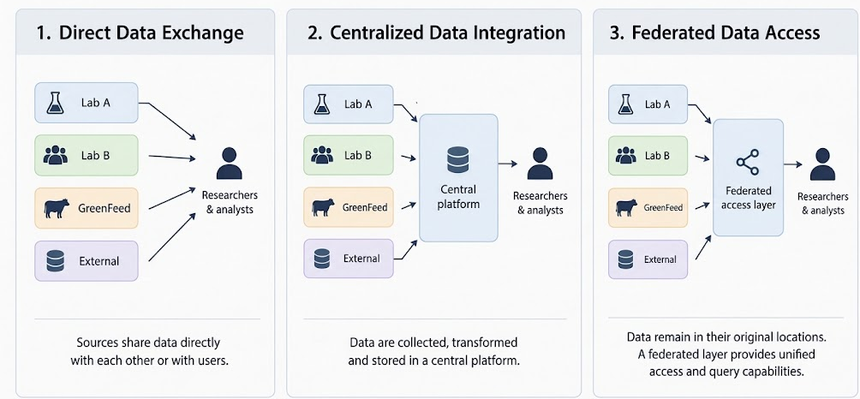
Data Exchange Approaches
Different ways to share and access data across multiple sources or organizations
Noor et al., 2026

Slide 5
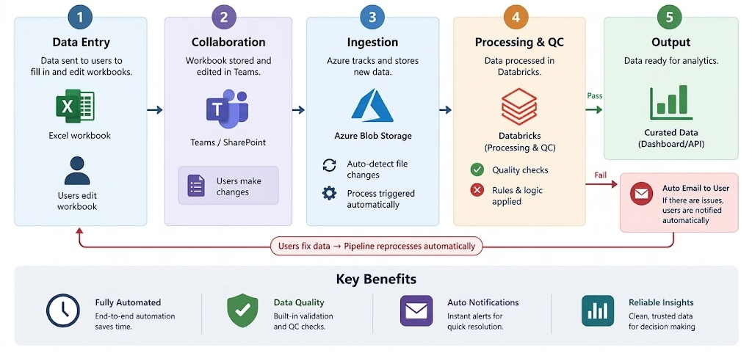
GEMS Data Pipeline
From multiple labs to a unified, standardized data platform for analysis.

Slide 6
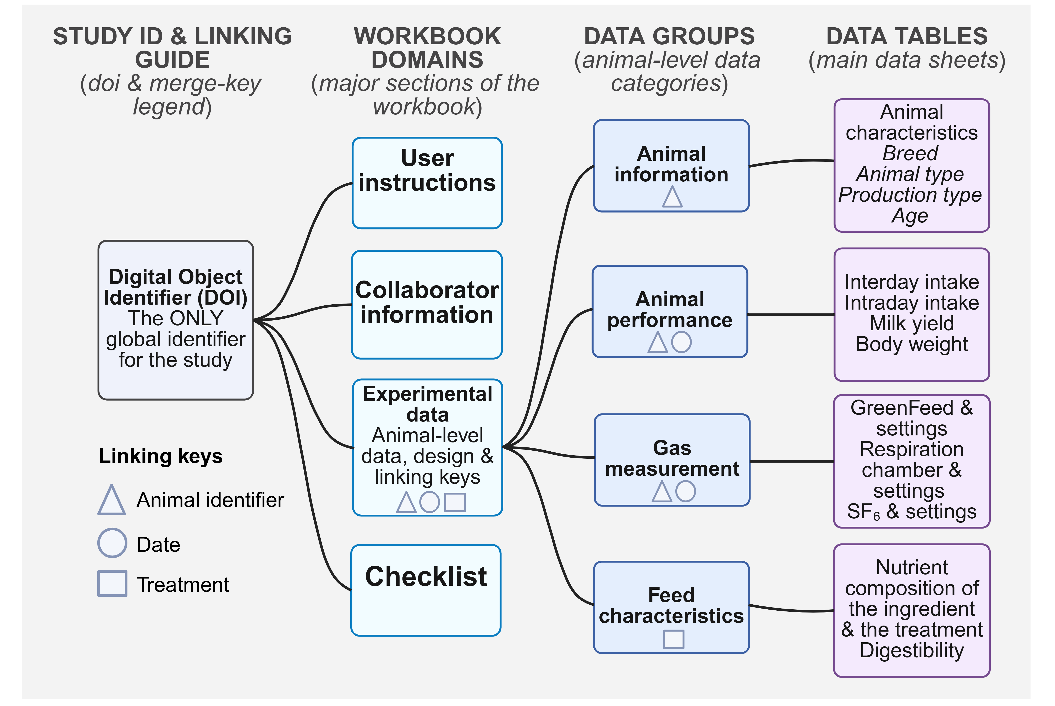
Data We Collect

Slide 7
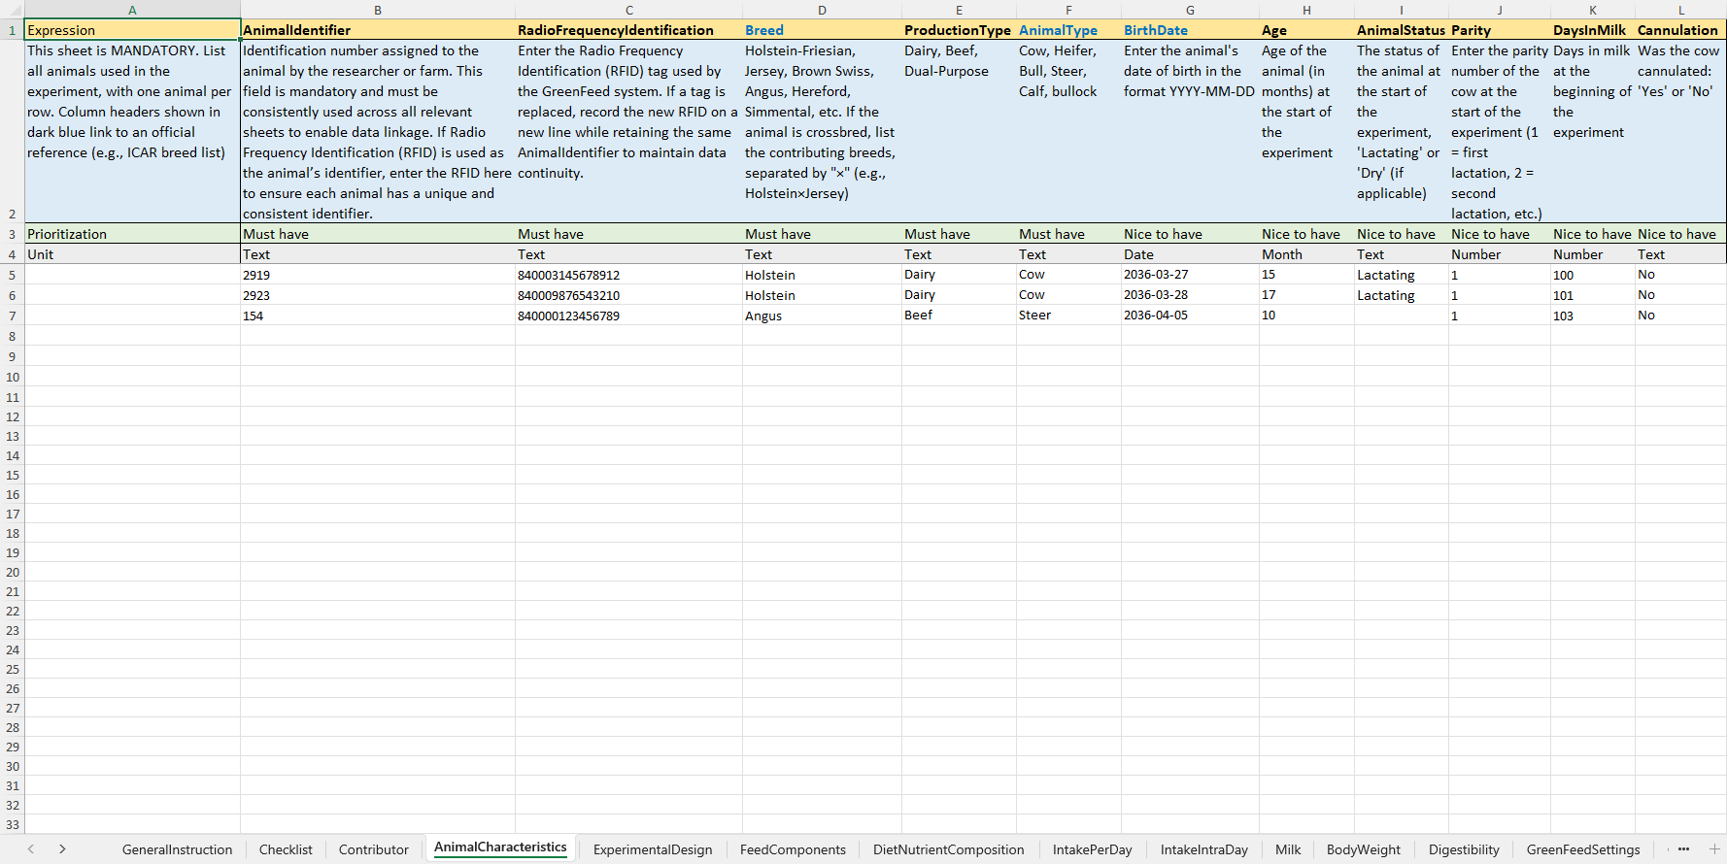
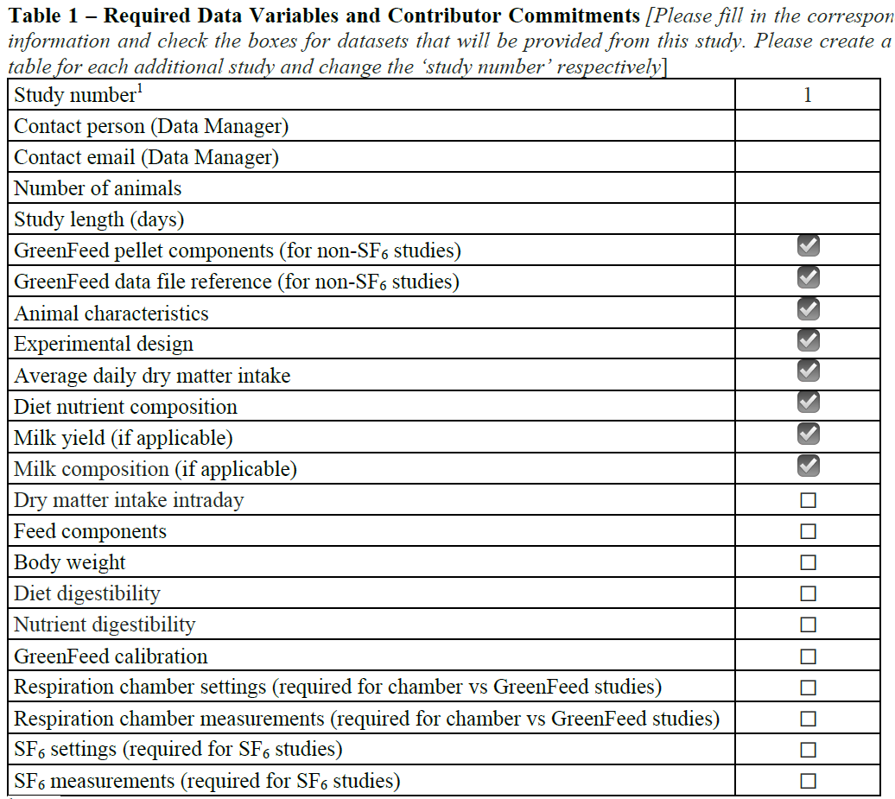
Data We Collect: data entry workbook and DUA

Slide 8
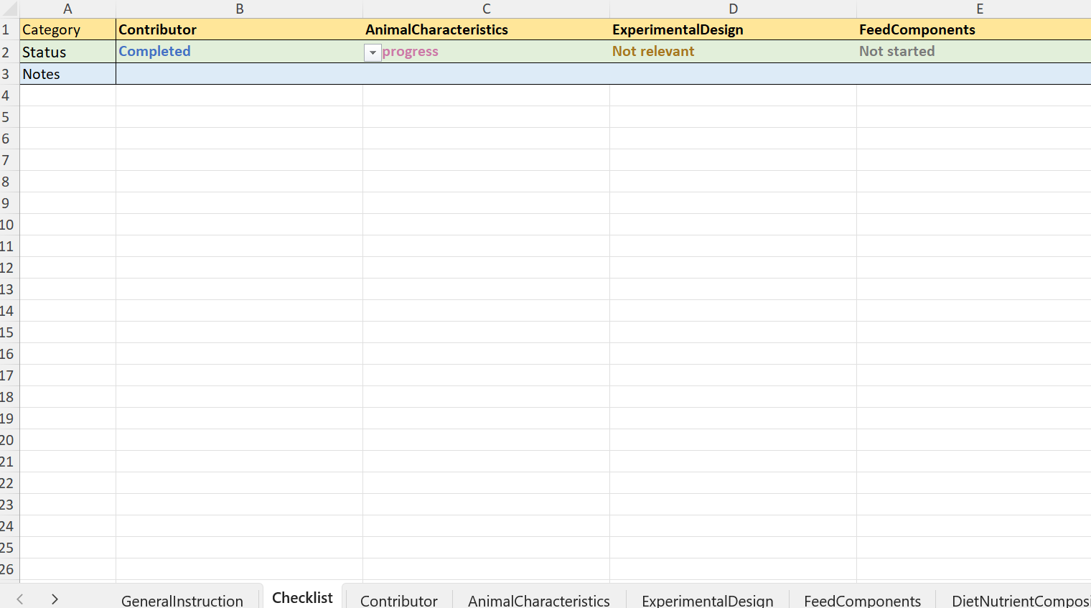
Data We Collect: data entry workbook

Slide 9

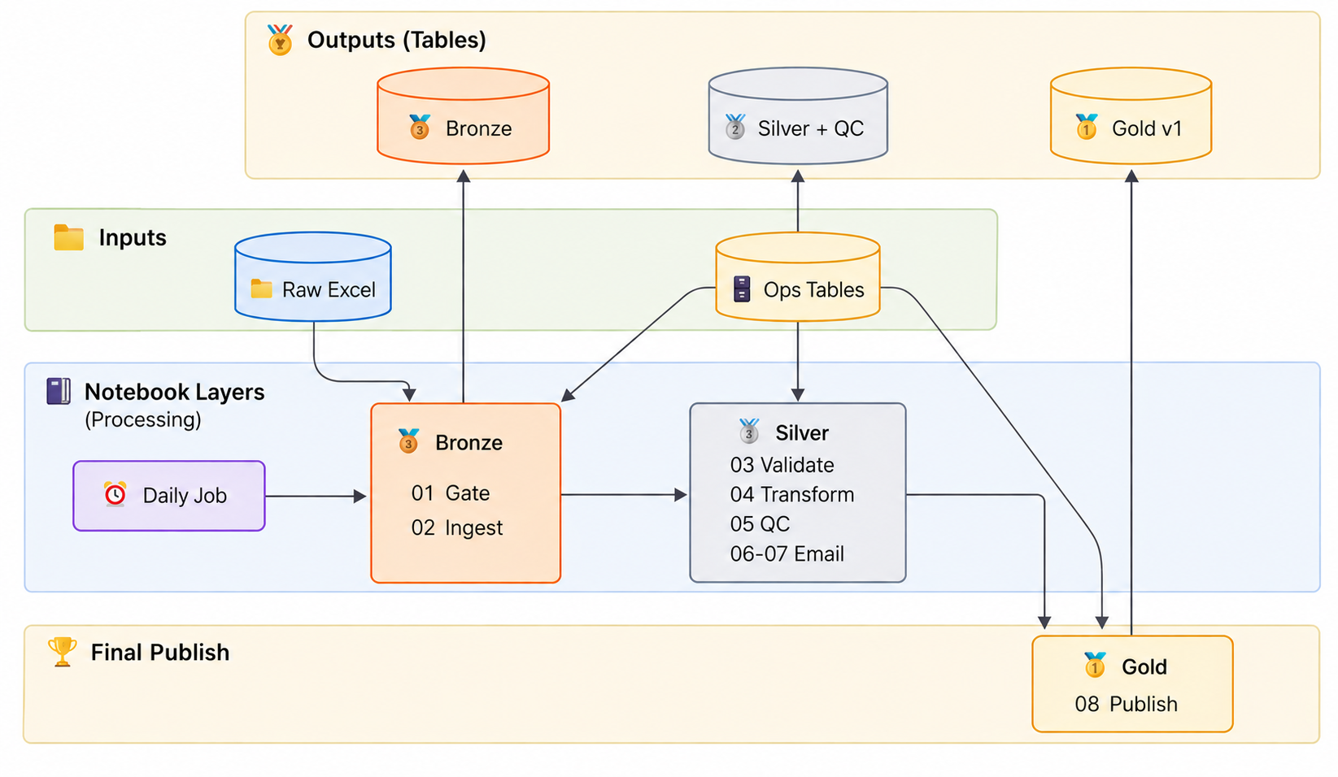
Data Transformation: medallion pipeline

Slide 10
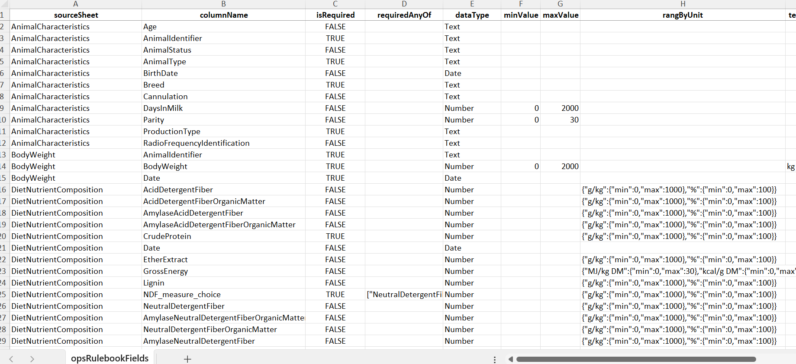
Data Validation: operational rule book

Slide 11
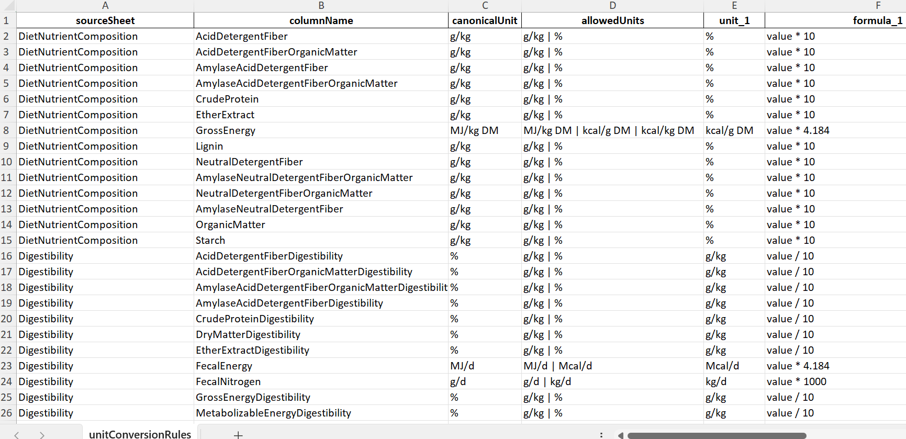
Data Validation: unit conversion

Slide 12
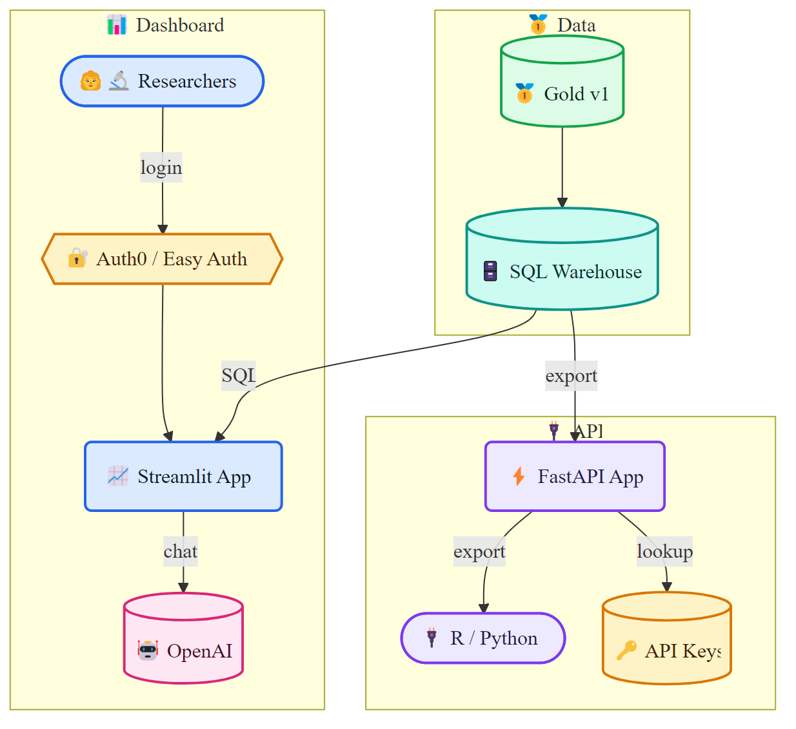
Data Delivery: data sharing and access

Slide 13
